Slide 1

https://www.pptxtemplates.com

Slide 2

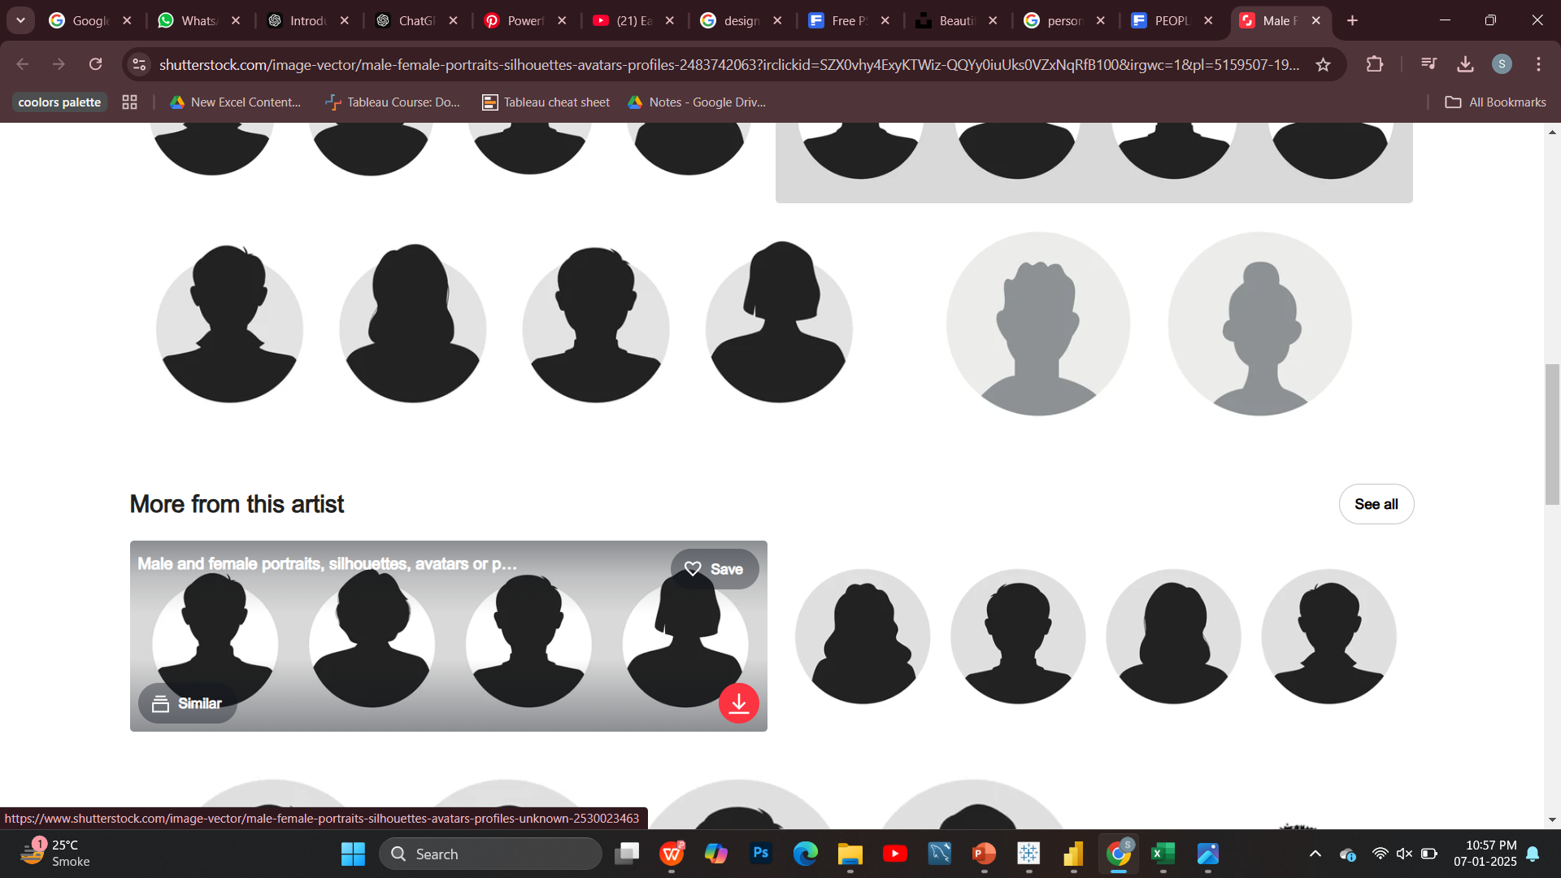
TEAM MEMBERS
KOMAL DOOLANI
SURABHI SAHOO
ARCHANA KUMARI

Slide 3
CONTENTS
1
INTRODUCTION
2
DATA OVERVIEW
3
KPI’S
4
ANALYSIS
5
RECOMMENDATIONS
6
CONCLUSION

Slide 4
INTRODUCTION
CONTENTS
Zomato is a food delivery and restaurant discovery platform that provides users with information about various eateries worldwide.
1
2
This project analyzes Zomato’s dataset, focusing on restaurants, cuisines, votes, ratings, service options, locations, and opening dates. It uncovers patterns and trends shaping the dining industry, offering insights into its dynamics.
2
3
Understanding these patterns can help improve service offerings and enhance user experience on the platform

Slide 5
DATA OVERVIEW
Zomato is a global restaurant aggregator and food delivery platform operating in over 15 countries, 9551 restaurants and many more . It provides a wealth of data, including restaurant information, customer reviews, ratings, pricing, and delivery metrics. This analysis delves into Zomato’s data to extract meaningful insights and trends that benefit stakeholders across the food service ecosystem
:
ATTRIBUTES:-Cusines, Ratings, Votes, Average Costs of two and delivery options.
Data related features:- Restaurant opening dates, financial months and quarters.
The Zomato dataset analysis explores restaurant performance and customer preferences across various countries. It focuses on identifying key trends and behaviors in the restaurant industry. The dataset has been cleaned and organized to provide meaningful insights for analysis.

Slide 6
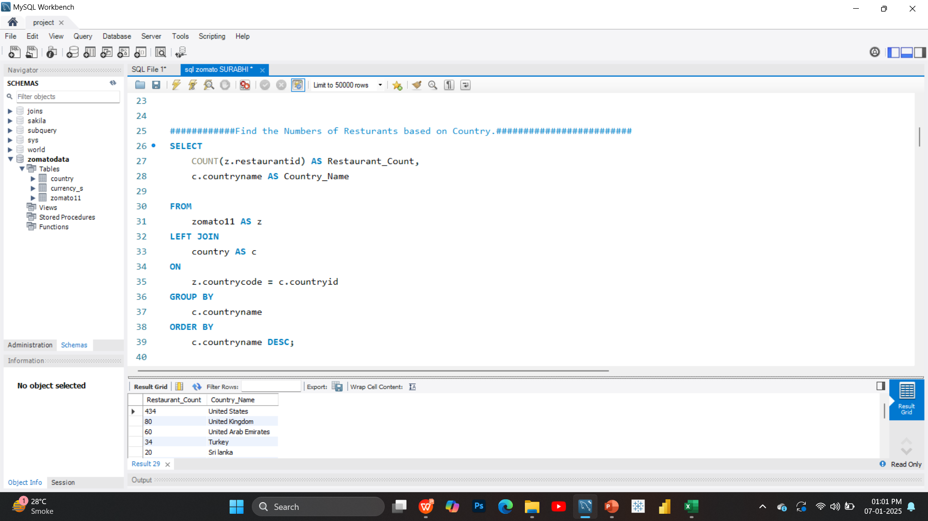
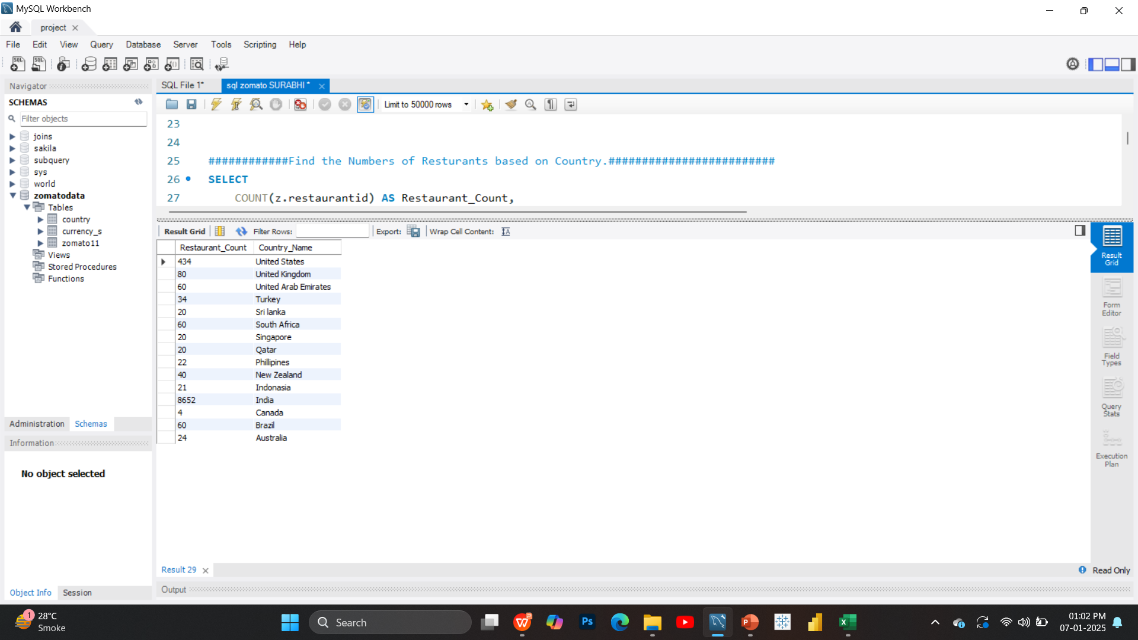
KEY PERFORMANCE INDICATORS
COUNTRY WISE RESTAURANTS
INSIGHTS:-
The restaurant counts country-wise chart provides valuable insights into the geographical distribution and density of restaurants listed on Zomato. It highlights Zomato's dominance in countries like India and US, reflecting strong market penetration and a diverse user base.

Slide 7
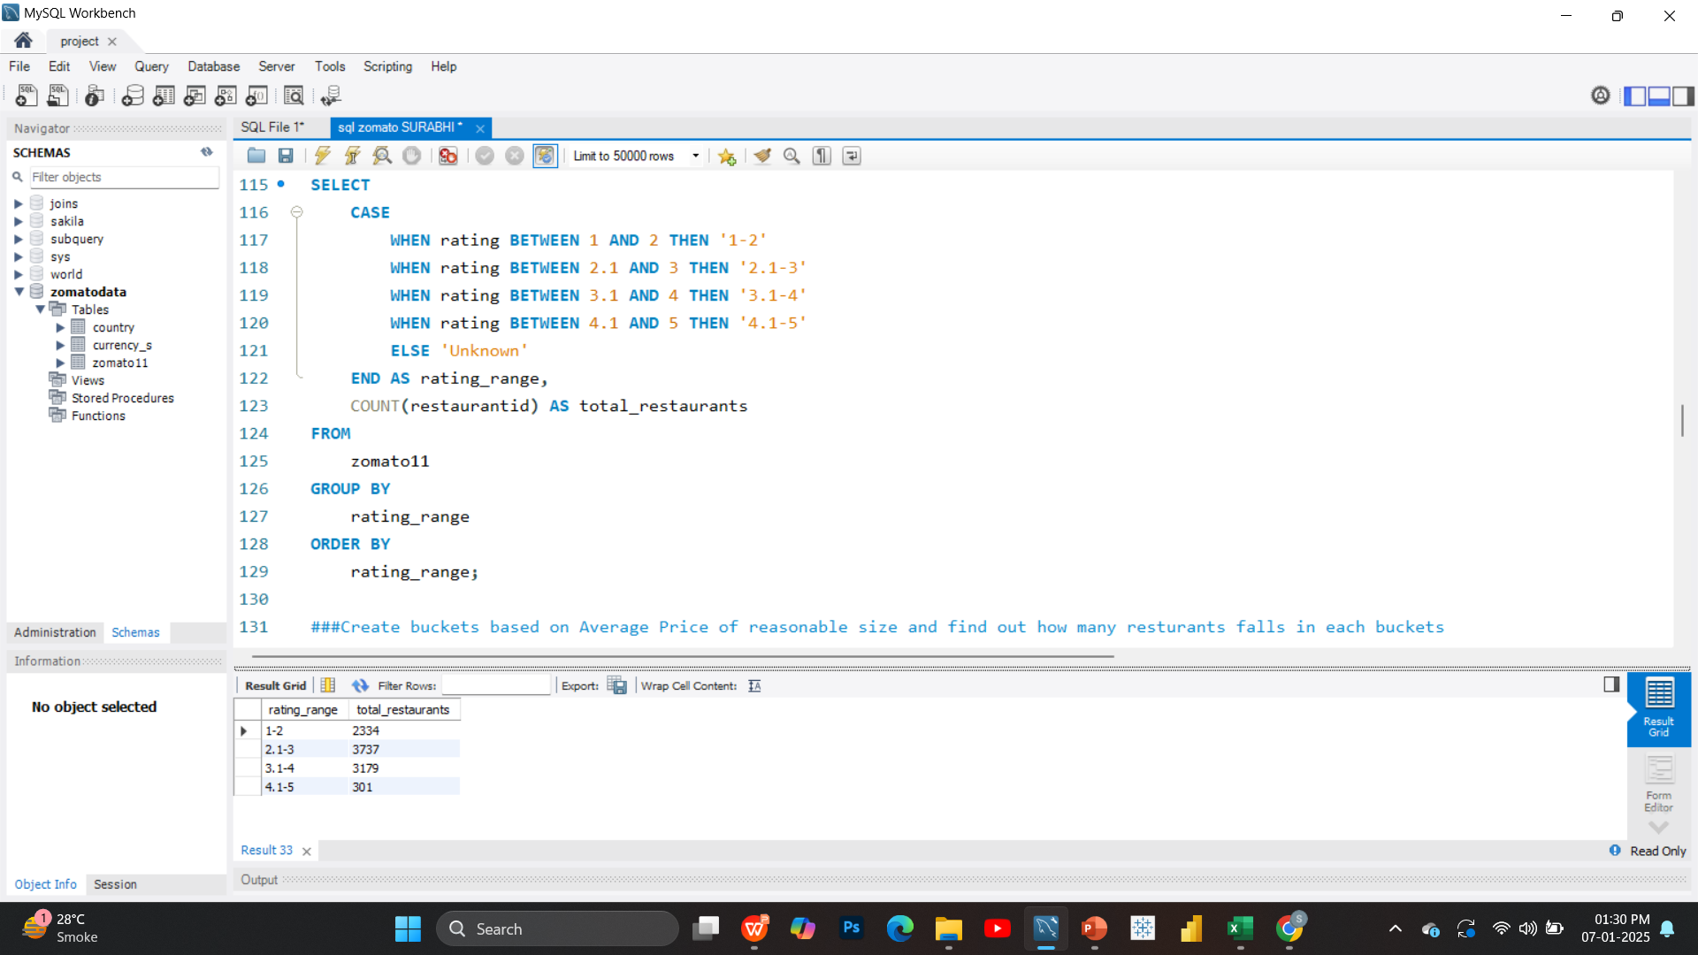
NO. OF RESTAURANTS BASED ON AVERAGE RATING
INSIGHTS:-
Highlight high-rated restaurants (4.0+) to build trust and attract more users to the platform. Provide tools and insights for low-rated restaurants to enhance service quality and boost customer satisfaction. Encourage more restaurants to join by showcasing the business benefits of maintaining strong ratings on the platform.

Slide 8
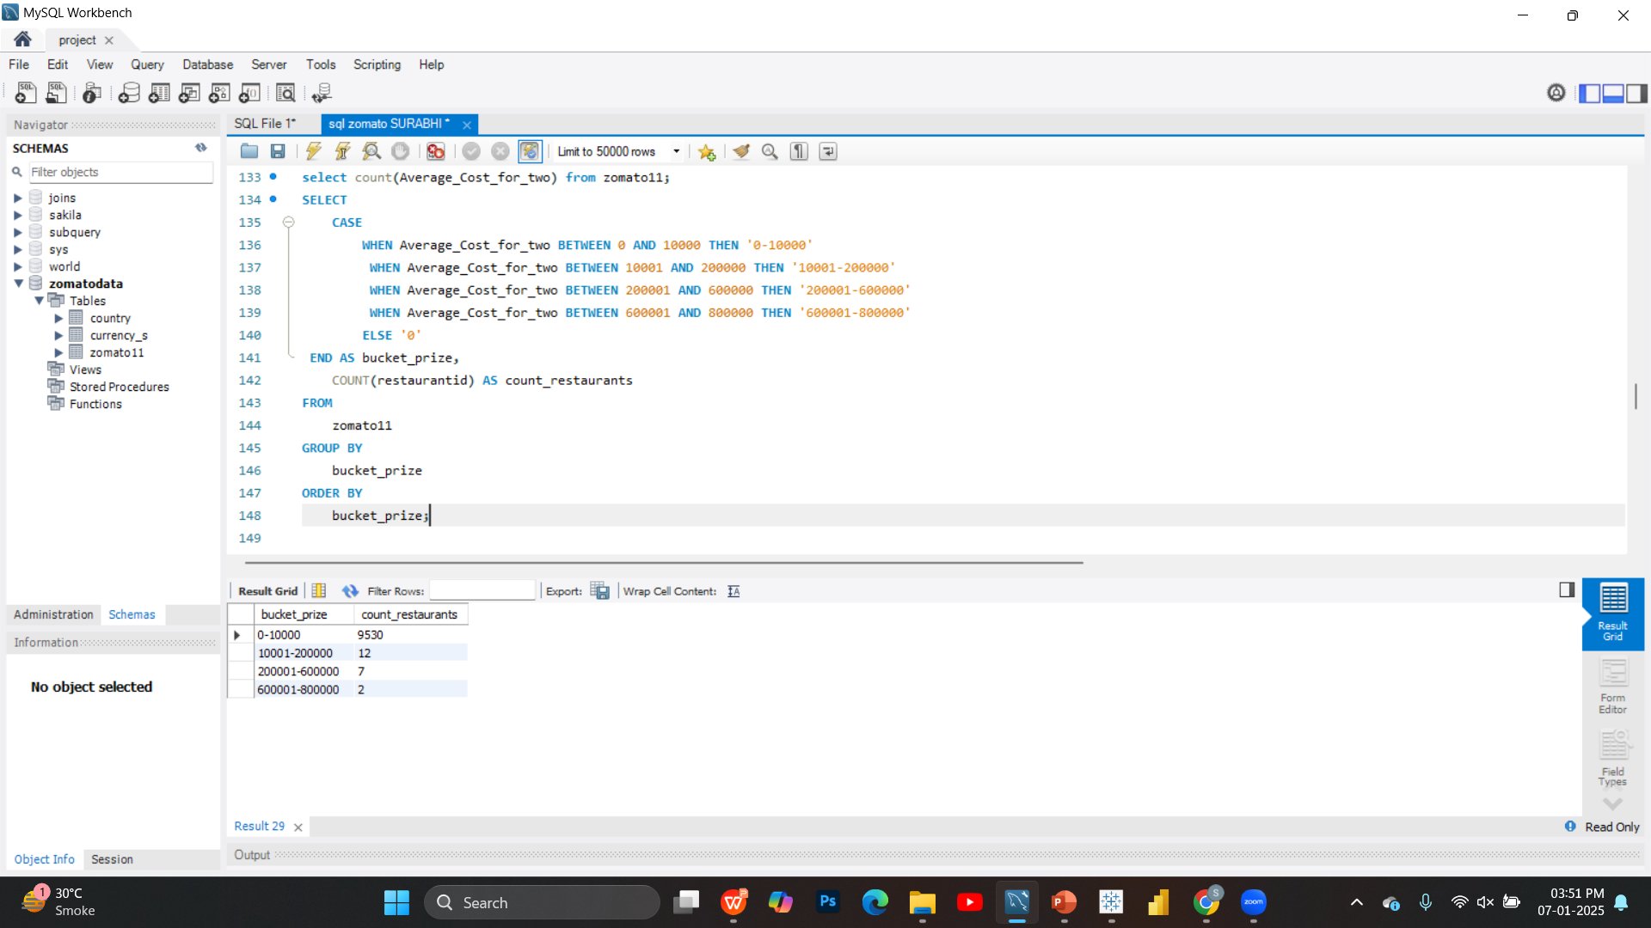

RESTAURANT COUNT BY BUCKET RANGE
INSIGHTS:-
The dominance of premium-lounge restaurants (8,118) highlights a focus on upscale dining, while low- (460) and mid-range (576) options are underrepresented, suggesting potential to attract budget-conscious users. High-range (397) restaurants are the smallest segment, signaling a gap to fill in mid-tier luxury dining.

Slide 9
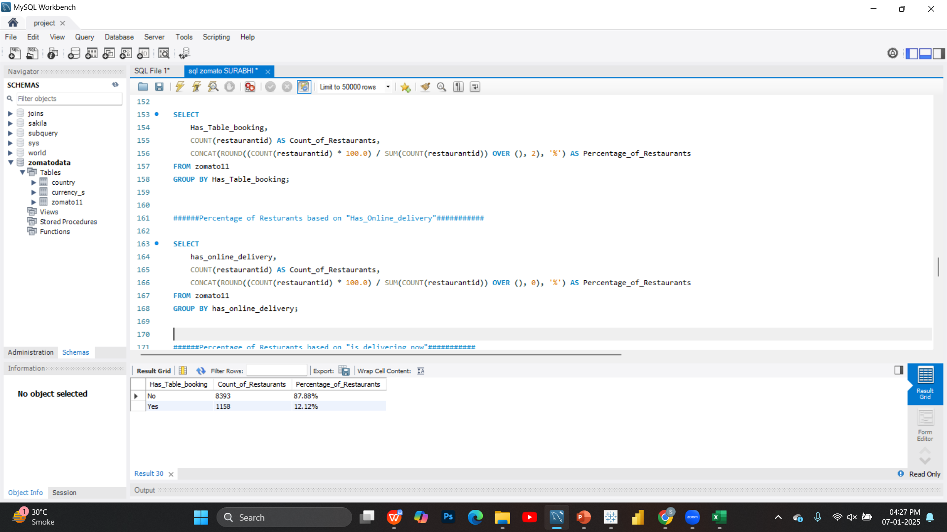
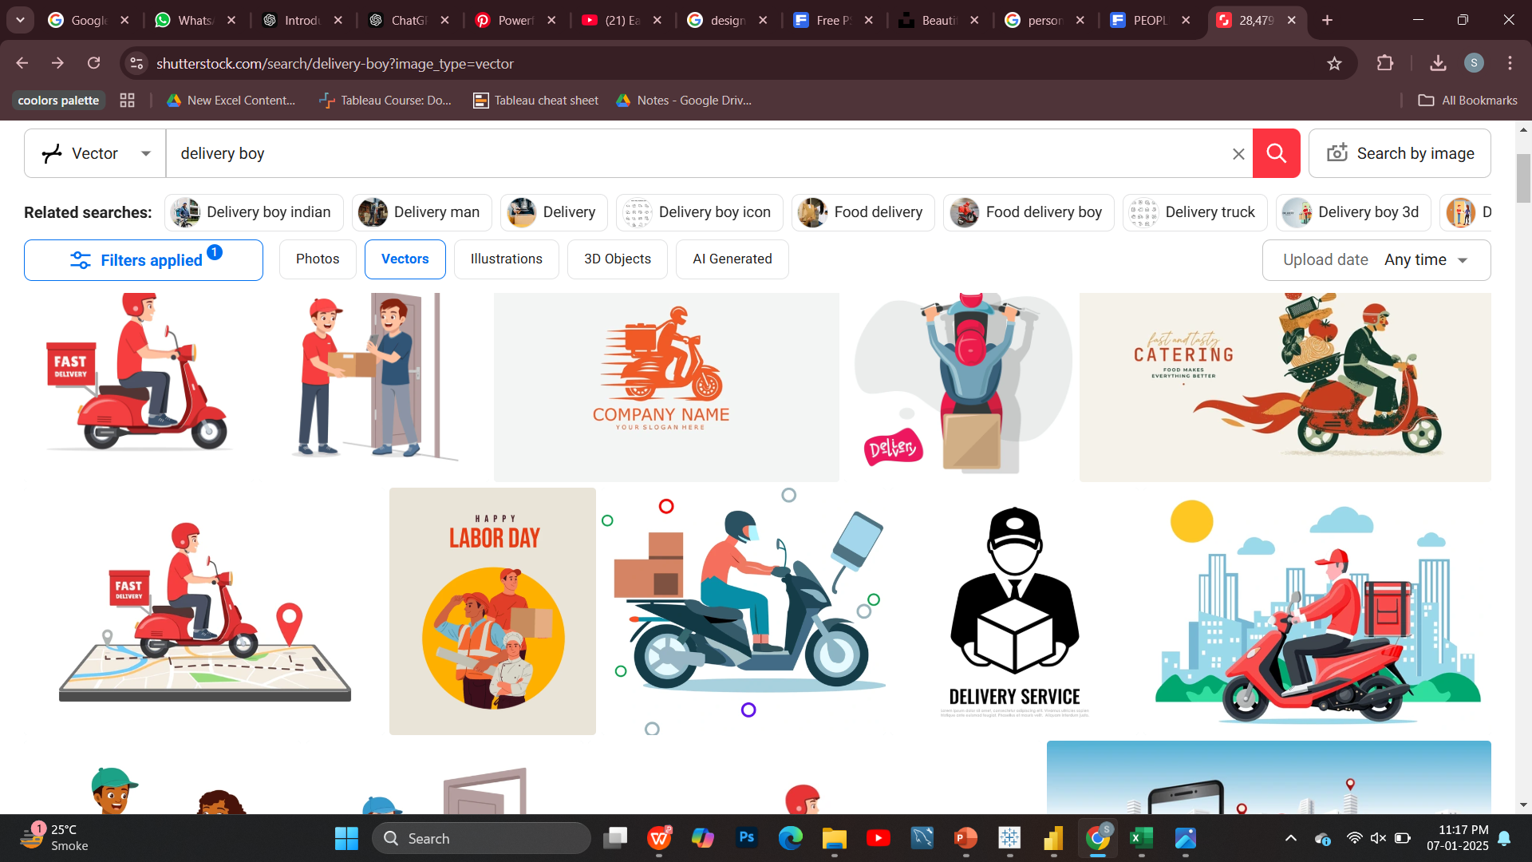

ONLINE DELIVERY/TABLE BOOKING
ONLINE DELIVERY
TABLE BOOKING
INSIGHTS:-
Most restaurants focus on online delivery, catering to convenience-driven customers, while table booking is popular among premium dining venues. Expanding delivery services and promoting table booking for mid-range restaurants can enhance customer options.

Slide 10
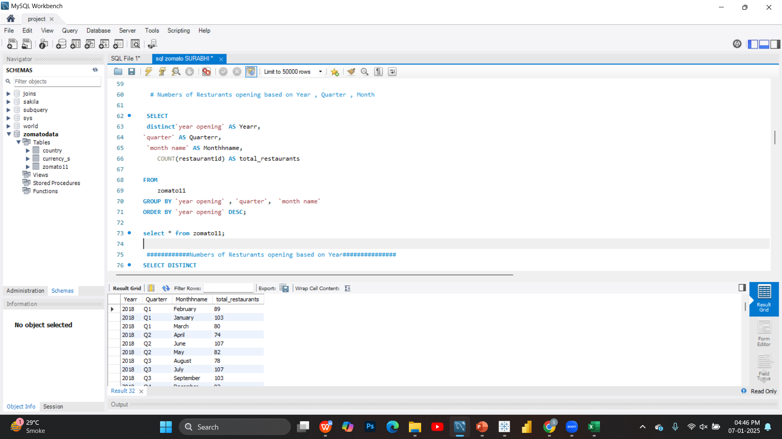
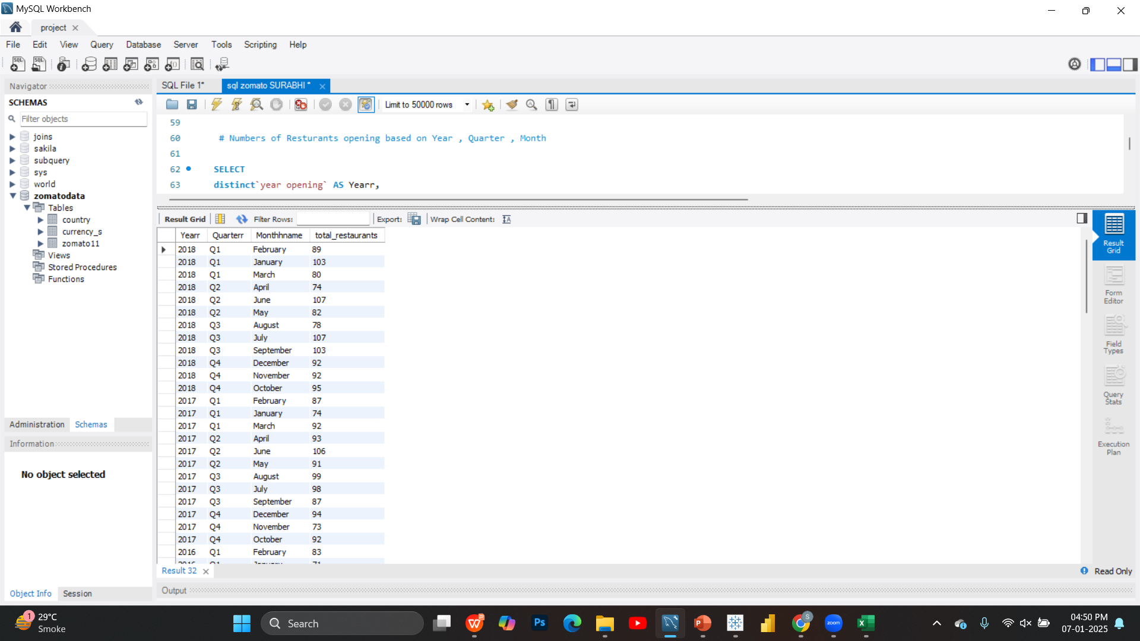
RESTAURANTS OPENINGS
Restaurant openings show patterns based on year, with growth in specific years, by quarter, peaking in certain seasons, and by month, often higher during festive or financial transitions.

Slide 11
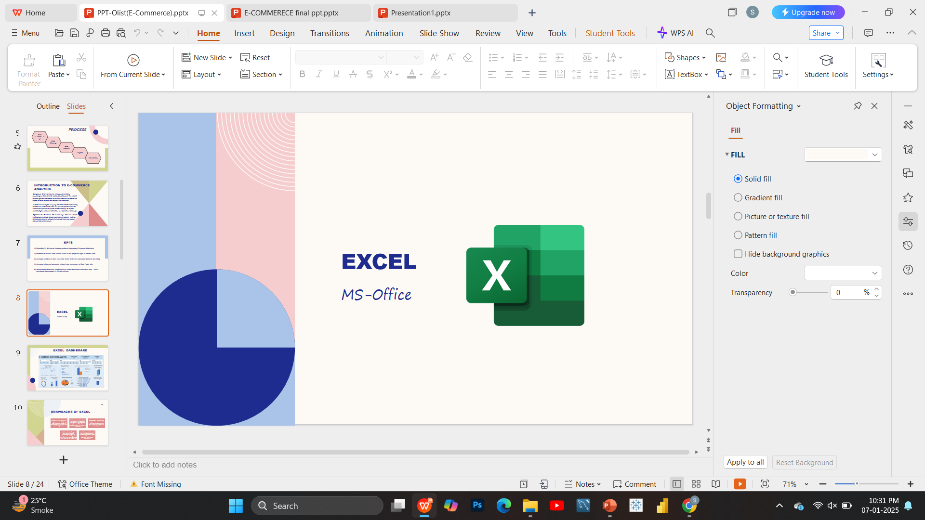
ANALYSIS
DASHBOARD

Slide 12
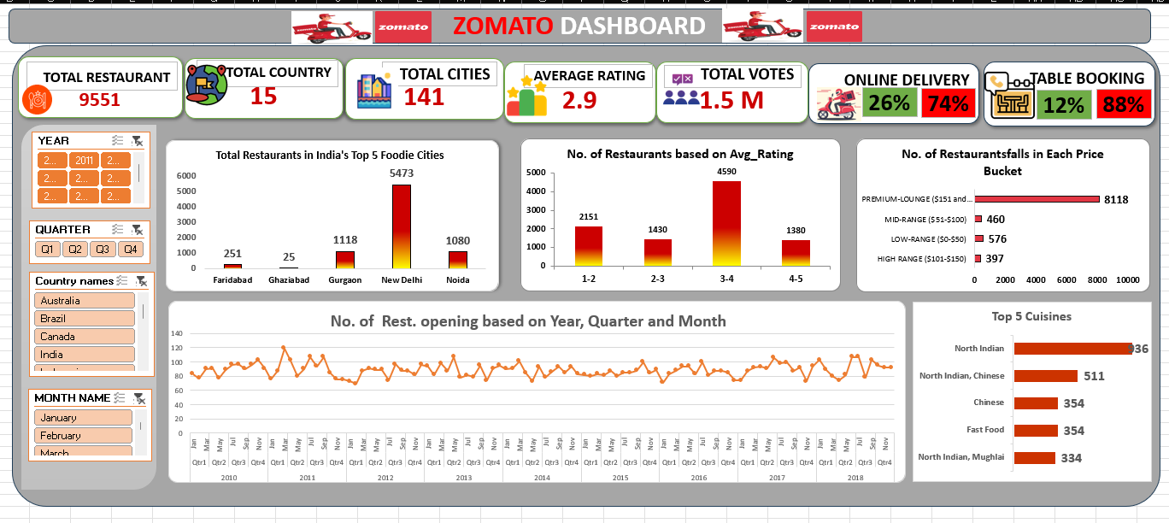

Slide 13
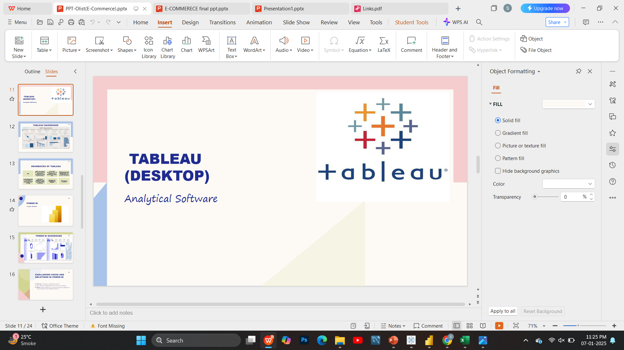
DASHBOARD

Slide 14
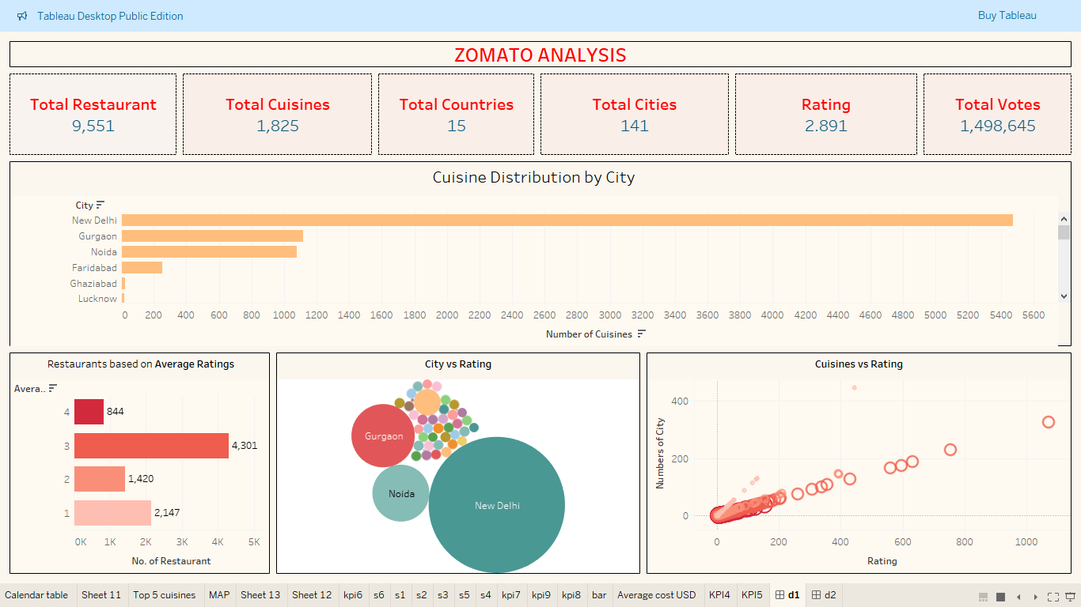

Slide 15
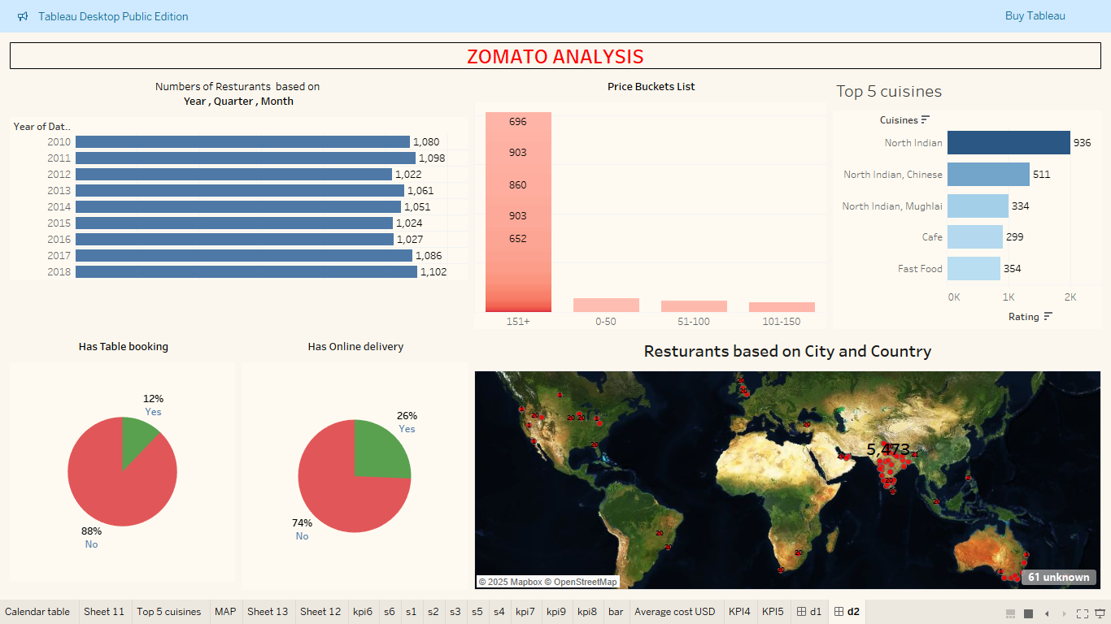

Slide 16
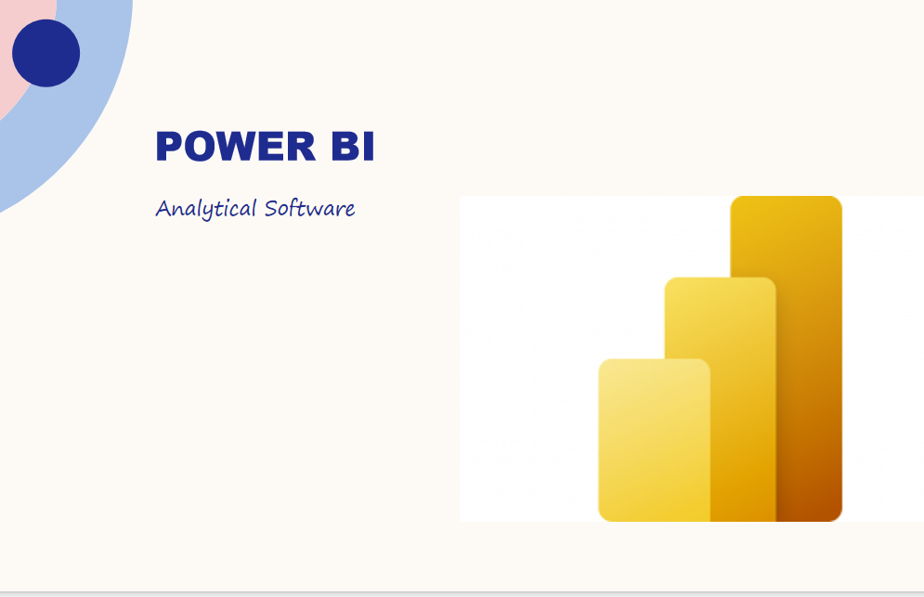
DASHBOARD

Slide 17
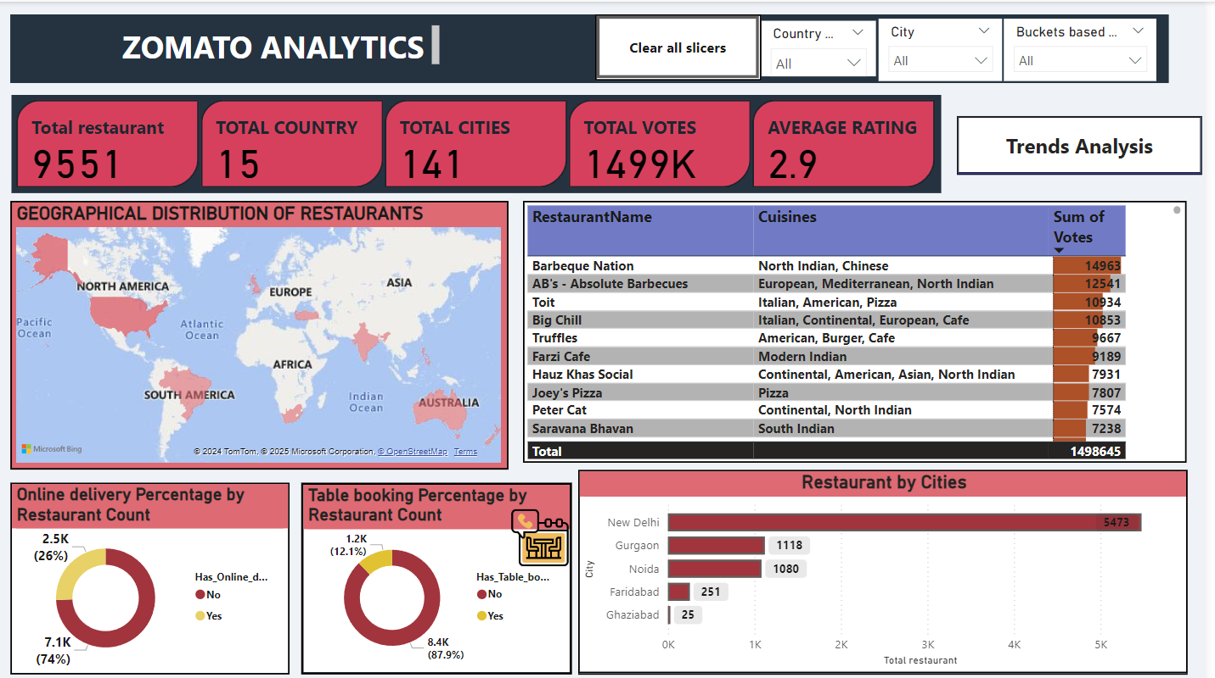

Slide 18
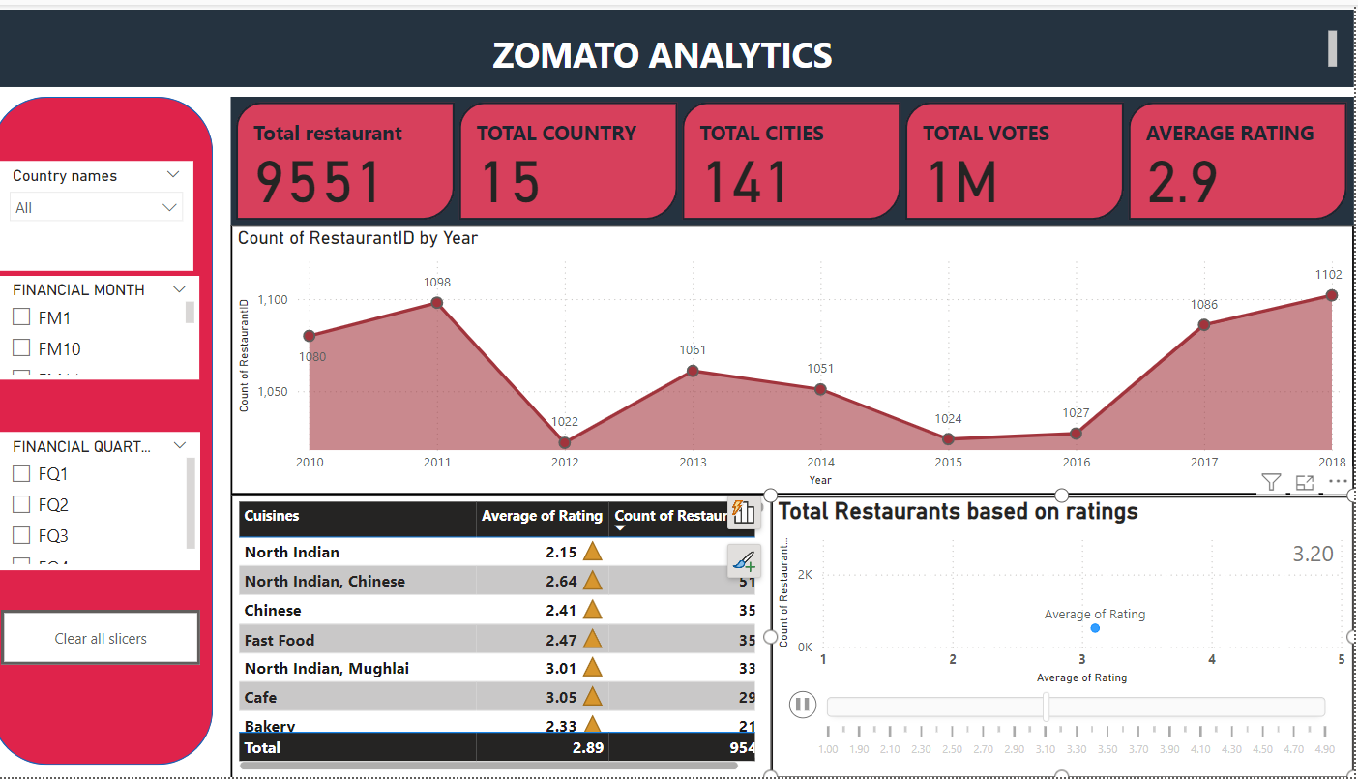

Slide 19
RECOMMENDATIONS
Restaurants with lower ratings should prioritize improving service quality and addressing customer feedback to enhance their reputation. Moreover, expanding delivery options, especially in high-demand areas, can significantly increase customer engagement and satisfaction.
Since the majority of restaurants fall into the low-cost range (₹0-200), there is a gap in premium offerings.
Segment cities based on income demographics to identify areas that require premium restaurants. Recommend adding premium dining options to diversify the offerings.

Slide 20
RECOMMENDATIONS
Online Delivery: Expand online delivery options, as only 26% of restaurants currently offer it. Target areas with high demand for convenience.
Table Booking: Increase adoption of table booking services to attract customers seeking hassle-free dining experiences.

Slide 21
CONCLUSION
Yearly Trends: The dashboards highlight consistent growth in restaurant counts over the years, emphasizing the need to focus on high-performing years and replicate success strategies.
Cuisines Popularity: North Indian cuisine dominates, suggesting a focus on diversifying underrepresented cuisines to attract broader customer segments.
Cost Analysis: Majority of restaurants fall in the mid-price range (201-400 Rs), indicating a potential market for premium or budget dining experiences.
Online Delivery & Table Booking: Low adoption of online delivery (26%) and table booking (12%) signifies untapped potential in leveraging technology to improve accessibility.
City Performance: Major cities like New Delhi and Gurgaon outperform others, highlighting opportunities for growth in smaller cities or regions with fewer restaurant counts.
Ratings Insights: Average ratings skew low, suggesting a focus on improving customer experiences and food quality to enhance brand perception.

Slide 22


